Slide 1
Architecture Changes
Christophe Fiessinger
http://blogs.msdn.com/chrisfie | http://twitter.com/cfiessinger
Product Marketing Manager
Microsoft Corporation

Slide 2
Agenda
What’s New in Architecture
Administration
Security
Permissions Modes

Slide 3
What’s new in Architecture

Slide 4
Important SharePoint Architecture Changes
Search Architecture
Request Management Service
App Management Service
Work Management Service
Office Web Apps now run separately
OData Support
Business Intelligence Enhancements
Windows Workflow Foundation 4
Watch SharePoint 2013 Ignite videos!!!

Slide 5
Work Management Service
Aggregate tasks to central place
Users can view and track their work and to-dos
Tasks cached to person’s newsfeed
Out of the box task aggregation with Microsoft SharePoint Products, Microsoft Exchange Server, and Microsoft Project Server
No configuration options in Central Administration
Implementation is based on provider model, so that additional systems maybe integrated to same architecture in future

Slide 6







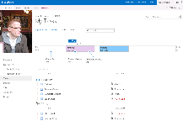









Detailed Architecture And Process Work Management Service
Service cache for tasks in MySite
Synchronous request for task to UI
Asynchronous cache request for providers
SharePoint
Project
Exchange
Timer job

Slide 7
Performance Improvements in All Three Tiers
Web Tier
Reduced Page load time
Wide Area Network (WAN) optimizations
Direct Business Objects database queries for non-queue jobs
Application Tier
Queue service optimization
Reduced number of database requests
Active Directory Synchronization Improvements
Database Tier
Optimized security validation
Data transfer improvements (i.e. using Table Value Parameters)
SQL best practices (i.e. daily maintenance jobs)
Multi-tenant Support

Slide 8
Focus on Page Performance
% improvement of page load times
Resource Center
71%
Timesheet
50%
Project Schedule
90%
Homepage
72%

Slide 9





Project Server 2013 Architecture
Browser
Project Professional 2013
PowerShell
3rd party on-premises applications
SharePoint Apps
WFE
ASPX Pages
Web Services
WCF Endpoints
CSOM
OData
Business Objects
Business Objects
Business Objects
Forwarder
Event Receiver
App
WCF Endpoints
Azure Workflow
Eventing
Queue
Calc
Workflow
Business Objects
Business Objects
Business Objects
SQL
Project
draft
SharePoint
publish
cubes
content
config
dbo
archive

Slide 10
Project Server 2013 Technologies
Hardware and software requirements for Project Server 2013 Preview
Multi-browser support
Project Server 2013 builds on SharePoint Server 2013
Project Server 2013/SharePoint 2013 architecture based on:
Microsoft .NET Framework 4.0
Microsoft ASP.NET 4.0 pages
Client Side Object Model (CSOM) programming interfaces
OData Open Data Protocol
OAuth Security in App Model

Slide 11
Single Project Server Database
Project Server is using a unique database for each Project Server instance
No more 4 DBs per instance like in Project Server 2010 and 2007
This database contains
4 groups of tables
Draft tables : “draft” prefix
Published tables : “pub” prefix
Archive tables: “ver” prefix
Reporting tables have no prefix to enable PS 2010 reports to work as is
Direct database access to “draft”, “pub”, “ver” tables is not supported

Slide 12

Scheduling Engines
New server-side scheduling engine
on par with the Project 2013 Preview client side scheduling engine
the Project Calculation Service implements the same scheduling engine that is in Project Professional 2013 Preview
The “Project Calculation Service” runs in a Windows Service named Microsoft Project Server Calculation Service

Slide 13
SharePoint & Project App model
What is an App?
“An app is typically a self-contained, interactive program that performs a small number of related tasks”
What is the new App model in SharePoint?
SharePoint applications no longer live in SharePoint
Custom code executes in the client, cloud or on-premises
Apps are granted permissions to SharePoint via OAuth
Apps communicate with SharePoint via REST / CSOM
Acquire apps via centralized Marketplace
Apps are for End Users
Cloud & Web-Oriented
Install and manage apps for SharePoint 2013

Slide 14
New Administration Locations
Aligned with SharePoint

Slide 15
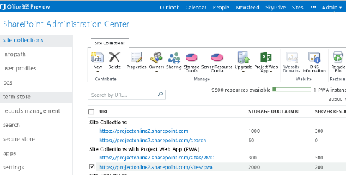
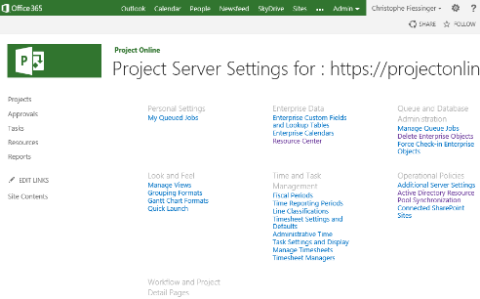
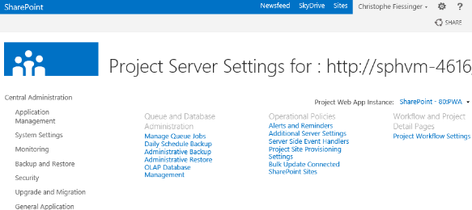
Two Administration Locations Depending on Role
SharePoint Central Administration for SP Admin
https://TENANTNAME-admin.sharepoint.com
Project Web App
http://TENANT/PWA/_layouts/15/pwa/Admin/Admin.aspx

Slide 16
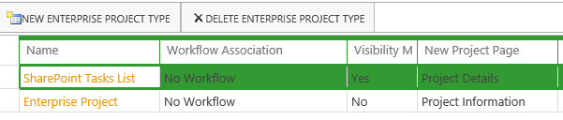
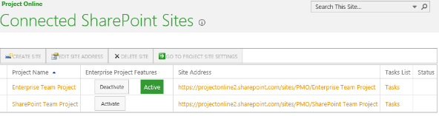
New: Project Type & Enterprise Project Features
New: SharePoint Tasks List Project
Team site is in control, tasks are managed in SharePoint
Enterprise Project Type
This is when Project Server has full control of the Projects and Tasks
New “grow-up” mode:
Enterprise Project Features
Activate/Deactivate PPM Features
PWA Settings > Operational Policies > Connected SharePoint Site

Slide 17
What’s New in Security?

Slide 18
Authentication and Authorization
SharePoint 2013 Preview continues to support claims and classic authentication modes
The default authentication mode is now Claims authentication
Classic authentication is still available, but only through PowerShell and not through the UI
Authentication Infrastructure main improvement : the Claims authentication cookie (“FedAuth” cookie) is tracked at the Distributed Cache Service level
No need to re-authenticate at each WFE like in SharePoint 2010!
New SharePoint Permission Mode

Slide 19
Permissions Modes

Slide 20
A Permissions Mode Determines
Where and how user permissions are managed
Where and how resources are created and managed
The management functionality that is available
The programmatic interfaces that are available
Permissions Mode is PWA site specific
A farm can host PWA sites in different permissions modes
Beneficial for large corporate or hosting environments

Slide 21
Project Server supports two permissions modes
SharePoint Permissions Mode
Permissions managed in SharePoint
Resources managed in Project Server
Project Server Permissions Mode
Permissions and Resources managed in Project Server
Default for upgraded sites
Plan user access in Project Server 2013 Preview

Slide 22
Comparison of features for security modes in Project Server
Feature | SharePoint permission mode | Project Server permission mode
Unified security management through SharePoint Server | ×
Permissions inheritance for PWA and Workspaces | ×
Direct authorization against Active Directory security groups | ×
Claims-based authorization | × | ×
Manage authorization by role-based groups | × | ×
Extensible and customizable | × | ×
User delegation |  | ×
Ability to secure work resources |  | ×
Impersonation |  | ×
Security filtering using the Resource Breakdown Structure |  | ×
Custom Security Categories |  | ×
http://technet.microsoft.com/en-us/library/fp161361(v=office.15)

Slide 23
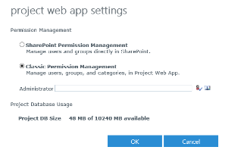
Changing Permissions Modes
Changing Permissions Mode is Destructive
Process re-initializes Security Model
Mode should not be changed often or casually
Changed Online from the SharePoint Admin setting
Changed on-premises using PowerShell
Set-SPProjectPermissionMode <URL> <Mode>
<Mode> = ProjectServer or SharePoint

Slide 24
Summary

Slide 25
Summary
Project Server 2013 contains significant architectural changes thanks to Project Online
Key resources
Product http://www.microsoft.com/project
Blog http://blogs.office.com/b/project/
TechNet http://technet.microsoft.com/en-us/projectserver/fp123546
MSDN http://msdn.microsoft.com/en-us/office/aa905469
Forums http://social.technet.microsoft.com/Forums/en-US/category/project

Slide 26

© 2012 Microsoft Corporation. All rights reserved. Microsoft, Windows, Windows Vista and other product names are or may be registered trademarks and/or trademarks in the U.S. and/or other countries.
The information herein is for informational purposes only and represents the current view of Microsoft Corporation as of the date of this presentation. Because Microsoft must respond to changing market conditions, it should not be interpreted to be a commitment on the part of Microsoft, and Microsoft cannot guarantee the accuracy of any information provided after the date of this presentation. MICROSOFT MAKES NO WARRANTIES, EXPRESS, IMPLIED OR STATUTORY, AS TO THE INFORMATION IN THIS PRESENTATION.

